Slide 1
CS6456: Graduate Operating Systems
Brad Campbell – bradjc@virginia.edu
https://www.cs.virginia.edu/~bjc8c/class/cs6456-f19/

Slide 2
Testing
Purpose:
Verifying functional correctness (vs. spec)
Verifying software completeness - no crashes, memory leaks, assert violations…

Slide 3
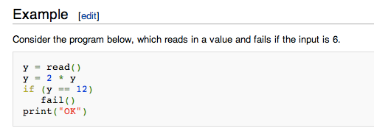
Random input test generation
Many more tests generated than manually
✘ Error path distribution is not uniform: Boundary values, zero-division…
Back to example: y being a 32 bit int

Slide 4
Symbolic execution
y is symbolic: y = s
y = 2 * s // still symbolic
Fork execution, add constraints to each path
true path constraint: 2*s==12
Need constraint solver

Slide 5
Constraint solver
2 * s == 12
CNF: ¬s1 ∧ ¬s2 ∧ ¬s3 ∧ ¬s4 ∧ s5 ∧ s6 ∧ ¬s7 ∧ ¬0
SAT solver: satisfiable? -> asserts instance -> test generate
2 * s
12
s1s2s3s4s5s6s70
00001100
00000010
s0s1s2s3s4s5s6s7
00001100

Slide 6
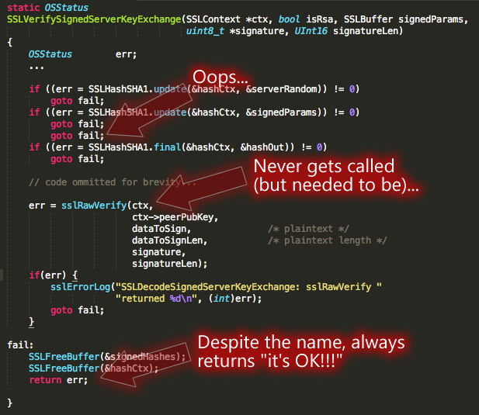
What is the goal?

Slide 7
Testing
Majority of the testing approaches are manual
Time consuming process
Error-prone
Incomplete
Depends on the quality of the test cases or inputs
Provides little in terms of coverage

Slide 8
Obvious Questions?
Yes, we can.
Can we do better in terms of test generation? Can we some how make it automatic?

Slide 9

Testing: example
Can y be 12?

Slide 10
Background: SAT
Given a propositional formula in CNF, find if there exists an assignment to Boolean variables that makes the formula true:
literals
ω₁ = (b c)
ω₂ = (¬ a ¬ d)
ω₃ = (¬ b d)
ϕ = ω₁ ω₂ ω₃
A = {a=0, b=1, c=0, d=1}
clauses
SATisfying assignment!

Slide 11
Background: SMT
SMT: Satisfiability Modulo Theories
Input: a first-order formula ϕ over background theory
Output: is ϕ satisfiable?
does ϕ have a model?
Is there a refutation of ϕ = proof of ¬ϕ?
For most SMT solvers: ϕ is a ground formula
Background theories: Arithmetic, Arrays, Bit-vectors, Algebraic Datatypes
Most SMT solvers support simple first-order sorts

Slide 12
Example SMT Solving
EX: b + 2 = c and f(read(write(a,b,3), c-2)) ≠ f(c-b+1)
b + 2 = c and f(read(write(a,b,3), c-2)) ≠ f(c-b+1)
[Substituting c by b+2]
b + 2 = c and f(read(write(a,b,3), b+2-2)) ≠ f(b+2-b+1)
[Arithmetic simplification]
b + 2 = c and f(read(write(a,b,3), b)) ≠ f(3)
[Applying array theory axiom–
forall a,i,v:read(write(a,i,v), i) = v]
b+2 = c and f(3) ≠ f(3) [NOT SATISFIABLE]

Slide 13
Program Validation Approaches
Static Analysis
Verification
Concolic Execution
& White-box
Fuzzing
Extended Static Analysis
Confidence
Symbolic Execution
Ad-hoc testing
Cost (programmer effort, time, expertise)

Slide 14
Automatic Test Generation Symbolic & Concolic Execution
How do we automatically generate test inputs that induce the program to go in different paths?
Intuition:
Divide the whole possible input space of the program into equivalent classes of input.
For each equivalence class, all inputs in that equivalence class will induce the same program path.
Test one input from each equivalence class.

Slide 15
Symbolic Execution --- History
1976: A system to generate test data and symbolically execute programs (Lori Clarke)
1976: Symbolic execution and program testing (James King)
2005-present: practical symbolic execution
Using SMT solvers
Heuristics to control exponential explosion
Heap modeling and reasoning about pointers
Environment modeling
Dealing with solver limitations

Slide 16
Symbolic Execution (contd.)
Void func(int x, int y){
int z = 2 * y;
if(z == x){
if (x > y + 10)
ERROR
}
}
int main(){ int x = sym_input(); int y = sym_input(); func(x, y); return 0;
}
SMT solver
Path
constraint
Satisfying
Assignment
Symbolic
Execution
Engine
High coverage test inputs
Symbolic Execution

Slide 17
Symbolic Execution --- Description
Execute the program with symbolic valued inputs (Goal: good path coverage)
Represents equivalence class of inputs with first order logic formulas (path constraints)
One path constraint abstractly represent all inputs that induces the program execution to go down a specific path
Solve the path constraint to obtain one representative input that exercises the program to go down that specific path

Slide 18
More details on Symbolic Execution
Instead of concrete state, the program maintains symbolic states, each of which maps variables to symbolic values
Path condition is a quantifier-free formula over the symbolic inputs that encodes all branch decisions taken so far
All paths in the program form its execution tree, in which some paths are feasible and some are infeasible

Slide 19
Symbolic Execution (contd.)
How does symbolic execution work?
Void func(int x, int y){
int z = 2 * y;
if(z == x){ if (x > y + 10) ERROR
}
}
int main(){ int x = sym_input(); int y = sym_input(); func(x, y); return 0;
}
func(x = a, y = b)
Path constraint
z = 2b
2b != a
2b == a
x = a = 0
y = b = 1
2b == a &&
a <= b + 10
2b == a &&
a > b + 10
ERROR
Generated
Test inputs
for this path
x = a = 2
y = b = 1
x = a = 30
y = b =15
Note: Require inputs to be marked as symbolic

Slide 20
Symbolic Execution (contd.)
How does symbolic execution work?
func(x = a, y = b)
x = a = 0
y = b = 1
x = a = 5
y = b = 4
x = a = 2
y = b = 3
………
z = 2b
2b != a
2b == a
x = a = 2
y = b = 1
x = a = 40
y = b = 20
………
x = a = 4
y = b = 2
………
2b == a &&
a <= b + 10
2b == a &&
a > b + 10
x = a = 30
y = b = 15
x = a = 0
y = b = 1
x = a = -6
y = b = -3
x = a = 48
y = b = 24
ERROR
Path constraints represent
equivalence classes of inputs
x = a = 2
y = b = 1
x = a = 30
y = b =15

Slide 21
SMT Queries
Counterexample queries (generate a test case)
Branch queries (whether a branch is valid)
Path Constraints = {C₁, C₂, …, C_{n}}; SAT
If K
Use queries to determine validity of a branch
else path is impossible: C₁ ∧ C₂ ∧ … ∧ C_{n} ∧ ¬K is UNSAT
then path is impossible: C₁ ∧ C₂ ∧ … ∧ C_{n} ∧ K is UNSAT
then
else

Slide 22
Optimizing SMT Queries
Expression rewriting
Simple arithmetic simplifications (x * 0 = 0)
Strength reduction (x * 2^{n} = x << n)
Linear simplification (2 * x - x = x)
Constraint set simplification
x < 10 && x = 5 --> x = 5
Implied Value Concretization
x + 1 = 10 --> x = 9
Constraint Independence
i<j && i < 20 && k > 0; new constraint i = 20

Slide 23
Optimizing SMT Queries (contd.)
Counter-example Cache
i < 10 && i = 10 (no solution)
i < 10 && j = 8 (satisfiable, with variable assignments i → 5, j → 8)
Superset of unsatisfiable constraints
{i < 10, i = 10, j = 12} (unsatisfiable)
Subset of satisfiable constraints
i → 5, j → 8, satisfies i < 10
Superset of satisfiable constraints
Same variable assignments might works

Slide 24
How does Symbolic Execution Find bugs?
It is possible to extend symbolic execution to help us catch bugs
How: Dedicated checkers
Divide by zero example --- y = x / z where x and z are symbolic variables and assume current PC is f
Even though we only fork in branches we will now fork in the division operator
One branch in which z = 0 and another where z !=0
We will get two paths with the following constraints:
z = 0 && f, z != 0 && f
Solving the constraint z = 0 && f will give us concrete input values that will trigger the divide by zero error.
Write a dedicated checker for each kind of bug (e.g., buffer overflow, integer overflow, integer underflow)

Slide 25
Classic Symbolic Execution --- Practical Issues
Loops and recursions --- infinite execution tree
Path explosion --- exponentially many paths
Heap modeling --- symbolic data structures and pointers
SMT solver limitations --- dealing with complex path constraints
Environment modeling --- dealing with native / system/library calls/file operations/network events

Slide 26
Classic Symbolic Execution --- Practical Issues (possible solutions)
Infinite execution tree
Finitize paths by limiting the PC size (bounded verification)
Use loop invariants (verification)
Path explosion
Select next branch at random
Select next branch based on coverage
Interleave symbolic execution with random testing
Heap modeling
Segmented address space via the theory of arrays (Klee)
Lazy concretization (JPF)
Concolic lazy concretization (CUTE)
Path Constraints

Slide 27
Classic Symbolic Execution --- Practical Issues (possible solutions)
SMT solver limitations
On-the-fly expression simplification
Incremental solving
Solution caching
Counterexample caching
Substituting concrete values for symbolic in complex PCs (CUTE)
Environment modeling
Partial state concretization
Manual models of the environment (Klee)

Slide 28
Symbolic Execution Coverage Problem
Symbolic execution may not reach deep into the execution tree. Specially when encountering loops.

Slide 29
Solution: Concolic Execution
Concolic = Concrete + Symbolic
Sometimes called dynamic symbolic execution
The intention is to visit deep into the program execution tree
Program is simultaneously executed with concrete and symbolic inputs
Start off the execution with a random input
Specially useful in cases of remote procedure call

Slide 30
Concolic Execution Steps
Generate a random seed input to start execution
Concretely execute the program with the random seed input and collect the path constraint
Example: a && b && c
In the next iteration, negate the last conjunct to obtain the constraint a && b && !c
Solve it to get input to the path which matches all the branch decisions except the last one
Why not from the first?

Slide 31
Concolic Execution
Random seed
x = 2, y = 1
Void func(int x, int y){
int z = 2 * y;
if(z == x){ if (x > y + 10) ERROR
}
}
int main(){ int x = input(); int y = input(); func(x, y); return 0;
}
func(x = a, y = b)
Path constraint
z = 2b
2b != a
2b == a
2b == a &&
a <= b + 10
2b == a &&
a > b + 10
ERROR
x = a = 30
y = b =15

Slide 32


Slide 33
KLEE: symbolic executer
Architecture: compiles C code to LLVM byte code. Executes a symbolic interpreter.
Map LLVM instructions to constraints. Constraint solver: STP.
generates executable tests, independent of KLEE.
Used to check all GNU Coreutils and covered 90% lines: more than 15 year on-going manual test suite - in 89 hours.

Slide 34
KLEE - usage
Compile C programs to LLVM byte code and run KLEE interpreter with wanted parameters: $ llvm-gcc --emit-llvm -c tr.c -o tr.bc $ klee --max-time 2 --sym-args 1 10 10 --sym-files 2 2000 --max-fail 1 tr.bc

Slide 35
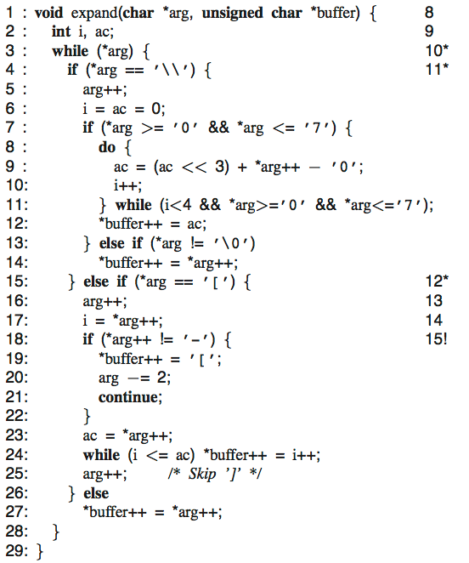
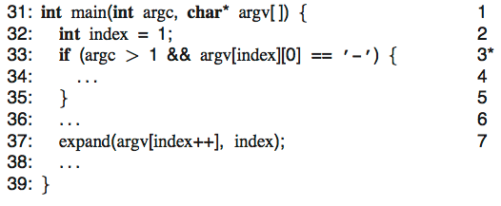
KLEE - symbolic execution: tr (Minix)
3 symbolic arguments
Fork execution
Fork, constraint arg[0]==‘[‘
Detect bug (implicit array bounds checking) and generate test: input={“[“, “”, “”}
all 37 paths in 2 minutes

Slide 36
Klee: scalability challenges
Exponential number of paths
Expensive constraint solving
Interaction with environment

Slide 37
Challenge: exponential search space
Naïve exploration can easily get “stuck”
Use search heuristics:
Coverage-optimized search
Select path closest to an uncovered instruction
Favor paths that recently hit new code
Random path search
See [KLEE – OSDI’08]

Slide 38
Challenge: expensive constraint solving
Dominates runtime
Inherently expensive (NP-complete)
Invoked at every branch
Two simple and effective optimizations
Eliminating irrelevant constraints
Caching solutions
Dramatic speedup on our benchmarks

Slide 39
Eliminating irrelevant constraints
In practice, each branch usually depends on a small number of variables
…
…
if (x < 10) {
…
}
x + y > 10
z & -z = z
x < 10 ?

Slide 40
Caching solutions
Static set of branches: lots of similar constraint sets
2 ∗ y < 100
x > 3
x + y > 10
x = 5
y = 15
2 ∗ y < 100
x + y > 10
Eliminating constraints
cannot invalidate solution
x = 5
y = 15
2 ∗ y < 100
x > 3
x + y > 10
x < 10
Adding constraints often
does not invalidate solution
x = 5
y = 15
UBTree data structure [Hoffman and Koehler, IJCAI ’99]

Slide 41
Simple fixes result in dramatic improvements
Aggregated data over 73 applications
Time (s)
Executed instructions (normalized)

Slide 42
Challenge: calling OS environment
int fd = open(“t.txt”, O_RDONLY);
If all arguments are concrete, forward to OS
Otherwise, provide models that can handle symbolic files
Goal is to explore all possible legal interactions with the environment
int fd = open(sym_str, O_RDONLY);

Slide 43
Environment modeling
// actual implementation: ~50 LOC
ssize_t read(int fd, void *buf, size_t count) {
exe_file_t *f = get_file(fd);
…
memcpy(buf, f->contents + f->off, count)
f->off += count;
…
}
Plain C code run by KLEE
Users can extend/replace environment w/o any knowledge of KLEE internals
Currently: effective support for symbolic command line arguments, files, links, pipes, ttys, environment vars

Slide 44
Real world failures
int num_bytes = write(fd, buffer, 10);
Can this fail?
Yes!
Klee will occasionally return an error for syscalls.

Slide 45
Evaluation - Metrics
Line coverage, only executable: ELOC percentage
Doesn’t measure actual conditional paths used
Used also because the gcov profiler outputs it and its a common tool among testing tools.

Slide 46
Coreutils
All 89 Coreutils programs ran with command: ./run <tool-name> --max-time 60 --sym-args 10 2 2 --sym-files 2 8 [--max-fail 1]

Slide 47
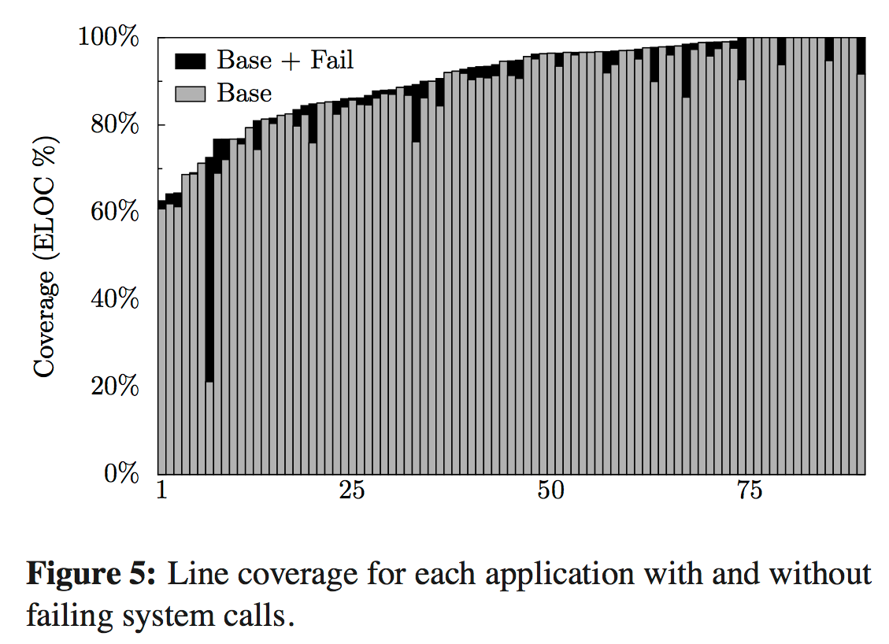

Coreutils
76.9% line coverage of all 89 Coreutils programs
pwd

Slide 48
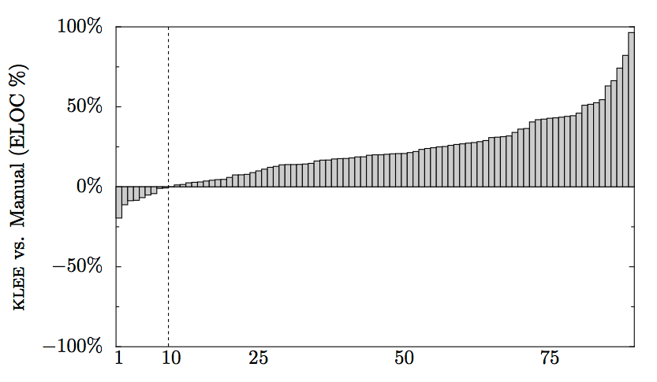
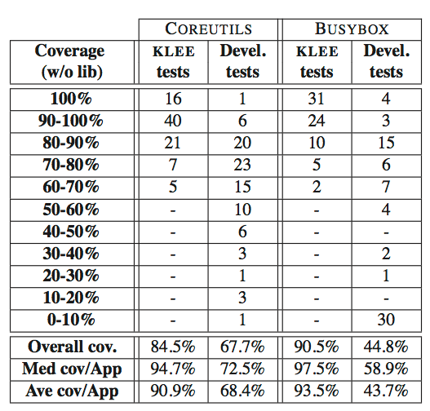
KLEE vs. manual suite
(LKLEE-Lman) / Ltotal

Slide 49
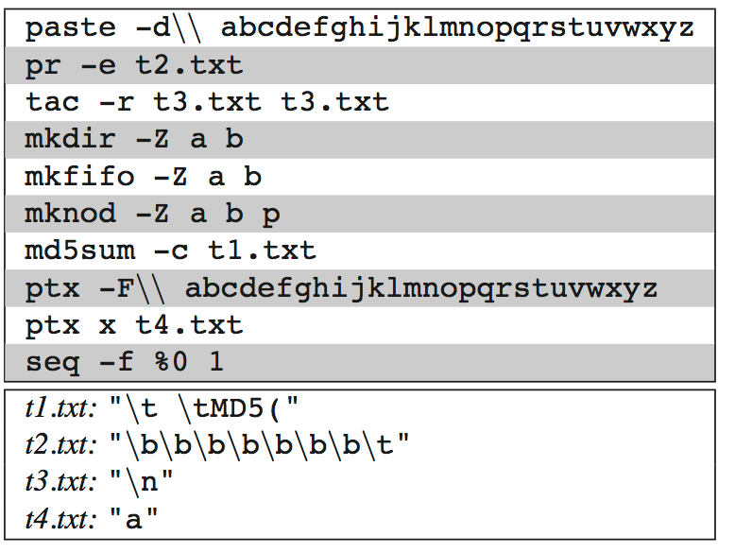
Bugs in real coreutils programs
Since 1992
Cause: modulus negative

Slide 50
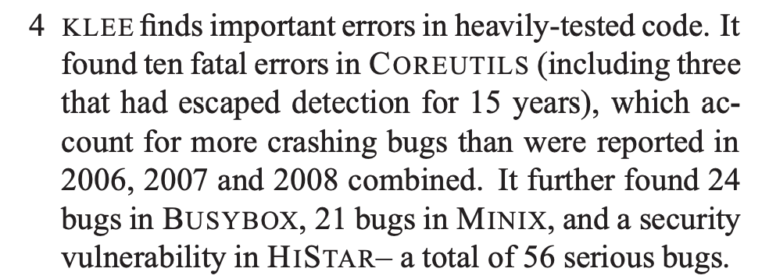
Quite a claim

Slide 51
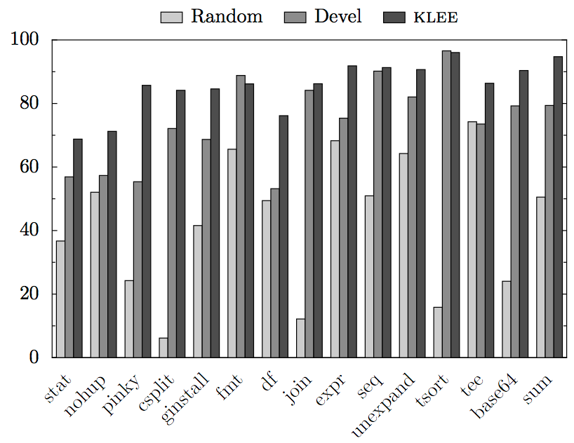
KLEE vs. random
Observation: random quickly gets the cases it can, and then revisits them over and over

Slide 52

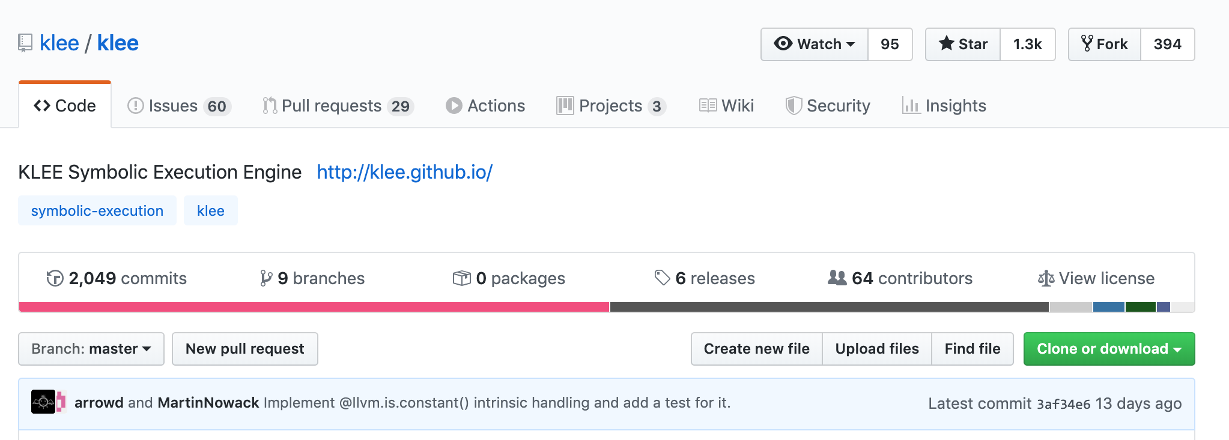


Lasting impact: KLEE today

Slide 53
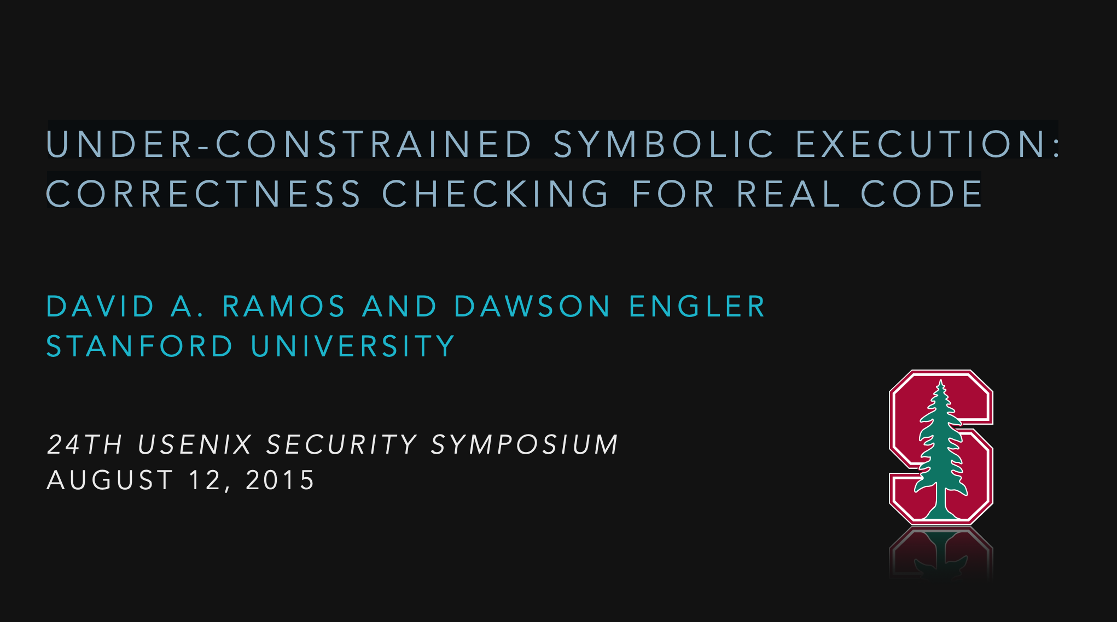

Slide 54
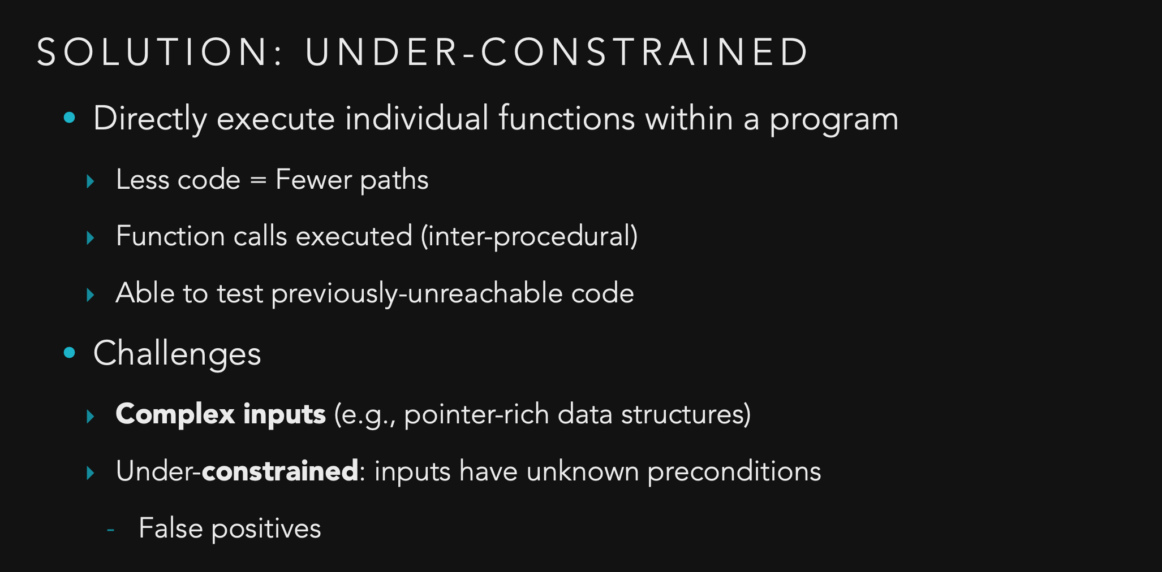

Slide 55
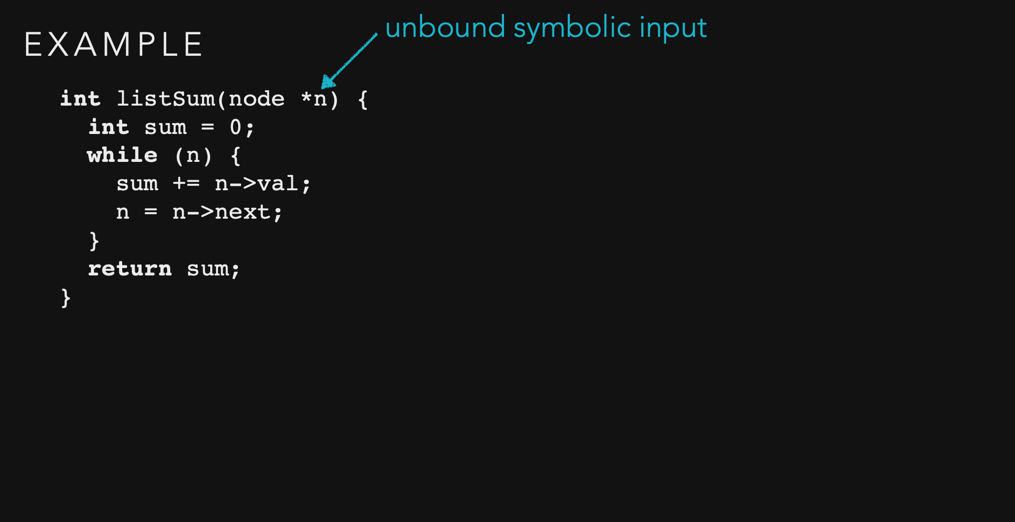

Slide 56
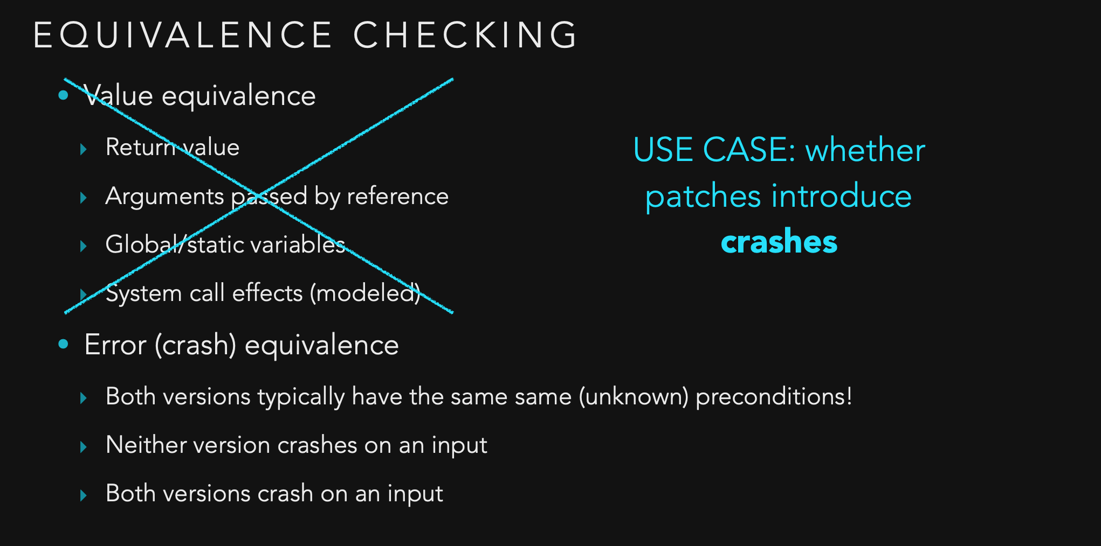

Slide 57
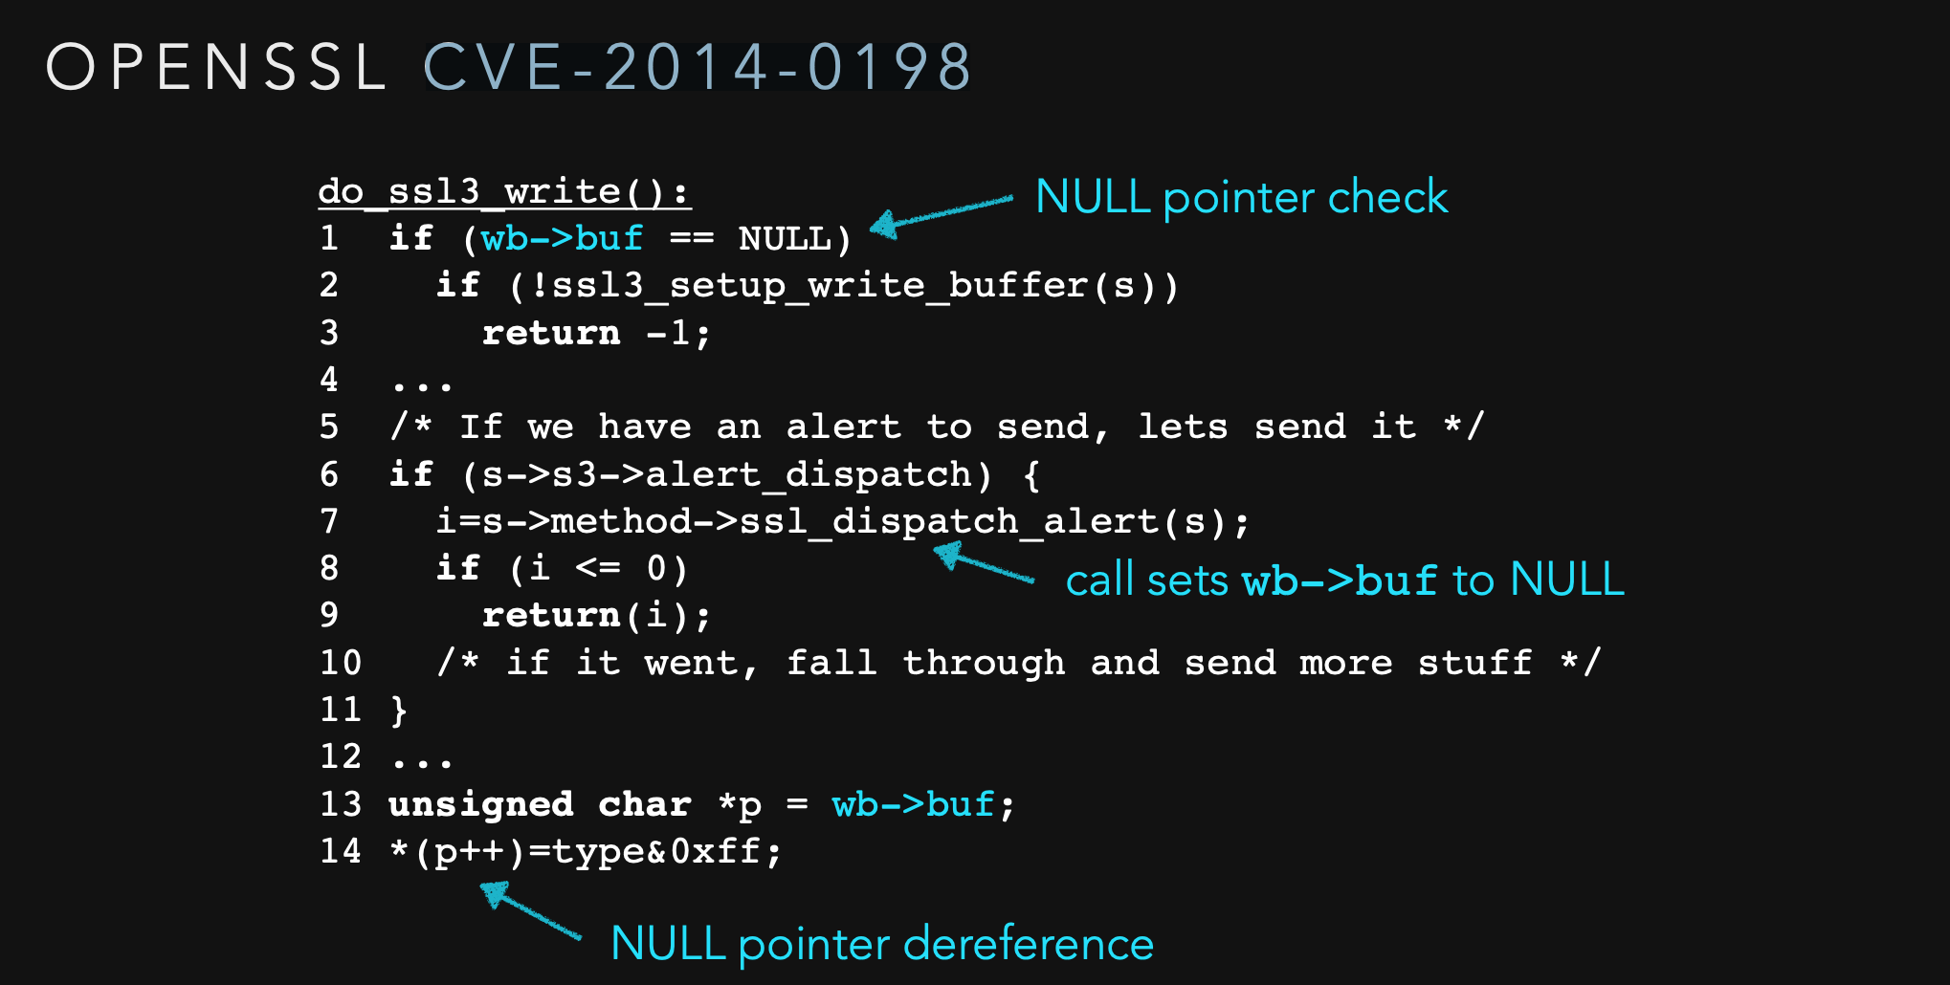

Slide 58
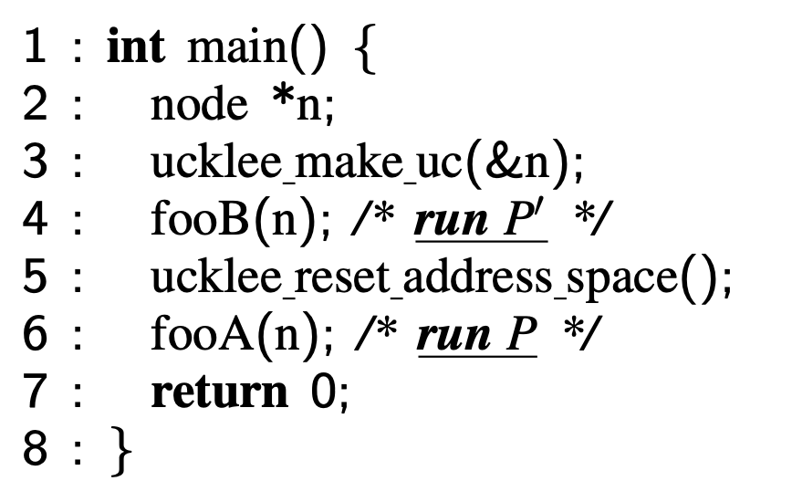
UC-KLEE patch testing
Generate unconstrained input
Run new version
When crash detected, go here
Follow same execution path in older version
Crash -> OK
No crash -> report error

